Slide 1

Color Detector using Arduino Uno
Presented by:
Batch No: 02
M. Sai Kishore (171FA05305)
R. V. L. Karthik (171FA05329)
S. Tushar (171FA05362)

Slide 2
Contents:
Introduction
Circuit Diagram
Components Required
Technical Specifications of TCS3200
Working
Hardware implementation
Applications

Slide 3
Introduction:
In this project we are going to interface TCS3200 color sensor with Arduino UNO. A Color Sensor, as the name suggests, is a device that senses or detects colors. A color sensor will use an external means of emitting light (like an array of white LEDs) and then analyze the reflected light from the object in order to determine its color. TCS3200 is a color sensor which can detect any number of colors with right programming. TCS3200 contains RGB (Red Green Blue) arrays. On microscopic level one can see the square boxes inside the eye on sensor. These square boxes are arrays of RGB matrix. Each of these boxes contain Three sensors, one is for sensing RED light intensity, one is for sensing GREEN light intensity and the last in for sensing BLUE light intensity. Experimental Set Up has been designed specifically for detecting frequency of RGB color. The LCD panel directly displays the color of the object. As the combination of all these colors gives different color. There are various software available which directly converts the combination of RGB frequency into desired color. The setup is absolutely self-contained and requires no other apparatus.

Slide 4
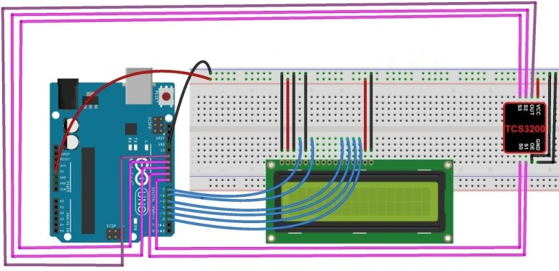
Circuit Diagram:

Slide 5
Components Required:
Arduino UNO Board
TCS3200 Color Sensor
16*2 LCD
Breadboard
Connecting Wires
Different colored objects

Slide 6
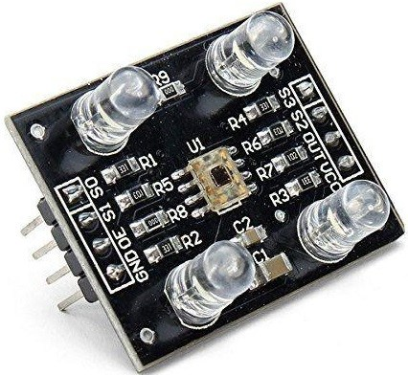
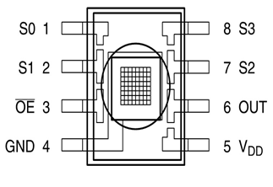
TCS3200 Color Sensor Description:
The TCS3200 RGB Color Sensor for Arduino has an array of photo detectors, each with either a red, green, or blue filter, or no filter (clear). The filters of each color are distributed evenly throughout the array to eliminate location bias among the colors. Internal to the device is an oscillator which produces a square-wave output whose frequency is proportional to the intensity of the chosen color.
The TCS3200 color sensor can detect a wide variety of colors based on their wavelength. This sensor is especially useful for color recognition projects such as color matching, color sorting, test strip reading and much more.

Slide 7
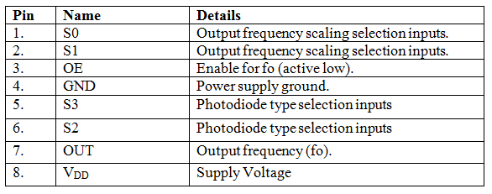
Pin details & specifications:

Slide 8
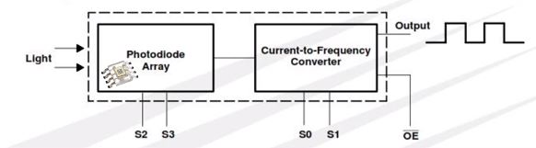
Working:
The TCS3200 senses color light with the help of an 8 x 8 array of photodiodes. Then using a Current-to-Frequency Converter the readings from the photodiodes are converted into a square wave with a frequency directly proportional to the light intensity. Finally, using the Arduino Board we can read the square wave output and get the results for the color.
To TCS3200, when choose a color filter, it can allow only one particular color to get through and prevent other color. For example, when choose the red filter, only red incident light can get through, blue and green will be prevented. So, we can get the red-light intensity. Similarly, when choose other filters we can get blue or green light.

Slide 9
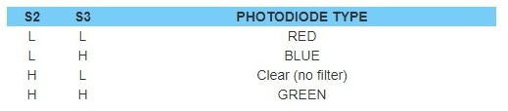
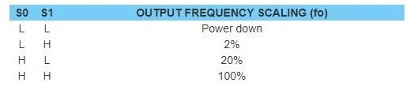
TCS3200 has four photodiode types. Red, blue, green and clear, reducing the amplitude of the incident light uniformity greatly, so that to increase the accuracy and simplify the optical. When the light project to the TCS3200 we can choose the different type of photodiode by different combinations of S2 and S3.
TCS3200 can output the frequency of different square wave (occupies empties compared 50%), different color and light intensity correspond with different frequency of square wave. There is a relationship between the output and light intensity. The range of the typical output frequency is 2HZ~500KHZ. We can get different scaling factor by different combinations of S0 and S1. Look at the form as follows.

Slide 10
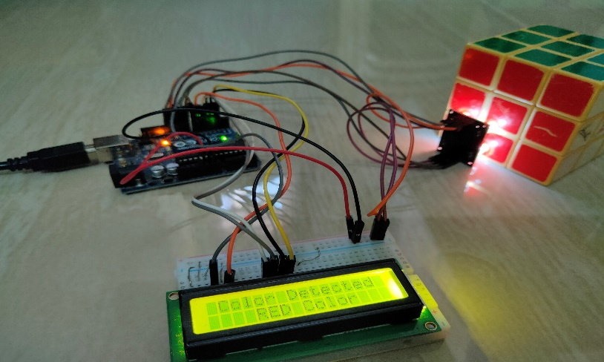
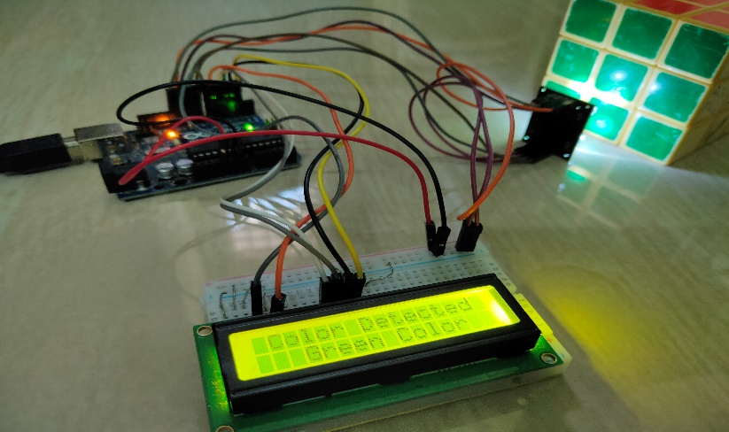
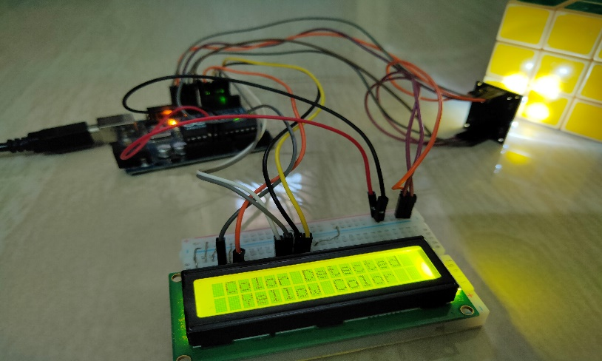
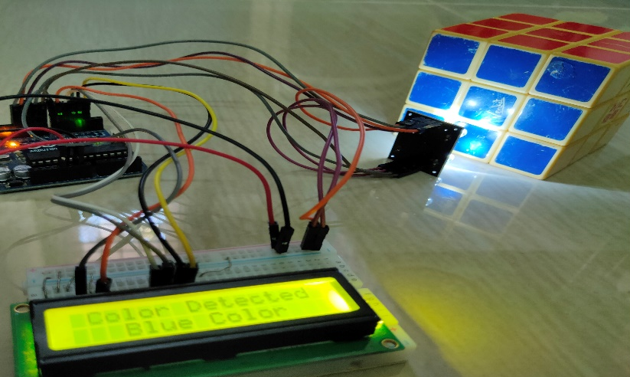
Hardware Implementation:

Slide 11
Applications:
Color Sensors have a wide range of applications in the fields of image processing, digital signal processing, object detection, color identification, etc.
In industries, Color sensors are often used in sorting objects based on color.

Slide 12
THANK YOU

